Slide 1
Clustering
Anindya Moitra
Aniket Chhabra

Slide 2
Why Segmentation?
Each individual is so different that ideally we would want to reach out to each one of them in a different way
1
2
3
4
5
6
…………………………..
Problem : The volume is too large for customization at individual level
1
2
3
4
Solution : Identify segments where people have same characters and target each of these segments in a different way

Slide 3
Unsupervised Learning
In this piece, we’ll look at methods to discover unknown relationships in data. These methods are called unsupervised methods. With unsupervised methods, there’s no outcome that you’re trying to predict; instead, you want to discover patterns in the data that perhaps you hadn’t previously suspected.
You are probably trying to unearth some hidden treasures !!
Example:
You may want to find groups of customers with similar purchase patterns, or correlations between population movement and socioeconomic factors.
Unsupervised analyses are often not ends in themselves; rather, they’re ways of finding relationship and patterns that can be used to build predictive models.
Supervised Learning | Unsupervised Learning
Its end objective is to arrive at final classification/prediction of the label Data | Unsupervised Learning works as an intermediate step in case of any supervised Learning
Supervised Learning will have a Dependent Variable to classify/predict using a set of Independent Variables | In case of Unsupervised Learning, there are no as such Dependent Variables that we want to model. It is more about exploring the feature universe and bring out structured information out of it
It works for primarily on the Label Data | It works for primarily on the Non-Label Data

Slide 4
Process Flow for Cluster Analysis
Collect and Prepare the data for analysis
Creating New Relevant Variables
Create Training and Validation datasets
Step 1
Step 2
Step 3
Multicollinearity Check
Treatment of Missing Values
Tackling the Outliers
Step 6
Step 5
Step 4
Getting Cluster Solution/Validation
Profile the clusters generated
Standardization
Step 7
Step 8
Step 9

Slide 5
Data Preparation- Outlier Treatment
What is an outlier?
An observation is said to be an outlier w.r.t. a variable if it is far away from the remaining observations.
Outlier
To identify them:
Univariate and Frequency analysis
Histogram and Box-Plot
Solution:
The outliers can be deleted from analysis if they are very small in number
2. The variables selected can be trimmed or capped/Floored.

Slide 6
Data Preparation- Missing Value Treatment
Variables with lot many (about 15%) missing values should not be used for clustering unless ‘Missing’ has a special significance and can be replaced by some meaningful number.
Note: - SAS does not include observations with missing values for Clustering Process
% of Missing
Treatments
Less than 1%
Delete those Observations
Mean Imputation
1-5%
Mean Imputation
Default value Imputation
5-10%
Regression Imputation
Mean Imputation
More than 10%
Regression Imputation
Try to use some proxy Variable

Slide 7
Data Preparation- Variable Standardization
Why do we need ‘Standardization’?
Since the units of measurement are different for different variables, standardization is a must.
E.g.: - Consider two variables, Age and Income.
The unit of Age is ‘Year’ and the unit of Income is say ‘Rs’.
Hence they are not comparable.
In that case there won’t be an unit of measurement for the distance between two clusters.
Generally we standardize by making the mean = 0 and variance = 1 thus deunitizing the variables and bringing them on a common platform to analyze.
For both K-Means or Hierarchical Clustering in R you can use scale() function to Standardize the variables.

Slide 8
Distance Calculation
Different measures are used to calculate the distance. In this section, we’ll cover a few of the most common ones:
Euclidean distance - The most common distance is Euclidean distance. The Euclidean distance between two vectors x and y is defined as
edist (x, y) <- sqrt((x[1]-y[1])^2 + (x[2]-y[2])^2 + ...)
This is the measure people tend to think of when they think of “distance.” Optimizing squared Euclidean distance is the basis of k-means. Of course, Euclidean distance only makes sense when all the data is real-valued (quantitative). If the data is categorical (in particular, binary), then other distances can be used.
HAMMING DISTANCE - For categorical variables (male/female, or small/medium/large), you can define the distance as 0 if two points are in the same category, and 1 otherwise. If all the variables are categorical, then you can use Hamming distance, which counts the number of mismatches:
Hdist (x, y) <- sum((x[1] != y[1]) + (x[2] != y[2]) + ...)
Here, a != b is defined to have a value of 1 if the expression is true, and a value of 0 if
the expression is false. In R you can use method=‘binary’ in the dist() function to calculate the Hamming distance.
MANHATTAN (CITY BLOCK) DISTANCE Manhattan distance measures distance in the number of horizontal and vertical units it takes to get from one (real-valued) point to the other (no diagonal moves)
Mdist (x, y) <- sum(abs(x[1]-y[1]) + abs(x[2]-y[2]) + ...)
This is also known as L1 distance (and squared Euclidean distance is L2 distance)
COSINE SIMILARITY Cosine similarity is a common similarity metric in text analysis. It measures the smallest angle between two vectors (the angle theta between two vectors is assumed to be
between 0 and 90 degrees). Two perpendicular vectors (theta = 90 degrees) are the most dissimilar; the cosine of 90 degrees is 0. Two parallel vectors are the most similar (identical, if you assume they’re both based at the origin); the cosine of 0 degrees is 1.
From elementary geometry, you can derive that the cosine of the angle between two
vectors is given by the normalized dot product between the two vectors:
dot(x, y) <- sum( x[1]*y[1] + x[2]*y[2] + ... )
Cossim (x, y) <- dot(x, y)/(sqrt(dot(x,x)*dot(y,y))
Apart from this there are quite a few distance measures like Jaccard Distance, Maholanobis distance etc. which is often used in many such exercises

Slide 9
Subjective Segmentation – Cluster Analysis
Cluster Analysis is a technique used for combining observations into groups such that-
Each group is homogeneous or compact with respect to certain characteristics i.e.. observations in each group are similar to each other.
Each group should be different from other groups with respect to the characteristics i.e.. observations of one group should be different from the observations of other groups.
Groups are mutually exclusive and collectively exhaustive
Total Population
Group 1
Group 2
Group 3
Group 4

Slide 10
Clusters Using Two Variables - Example
High
Example Cluster 1
High Balance
Low Income
Current
Balance
Medium
Example Cluster 2
High Income
Low Balance
Low
Low
Medium
High
Gross Monthly Income
Cluster 1 and Cluster 2 are being differentiated by Income and Current Balance. The objects in Cluster 1 have similar characteristics (High Income and Low balance), on the other hand the objects in Cluster 2 have the same characteristic (High Balance and Low Income).
But there are much differences between an object in Cluster 1 and an object in Cluster 2

Slide 11
More than Two Cluster Framework– Example
Consider a portfolio with 1000 PI active HHs. Business wants to make different strategies to different groups of HHs. Not a case for ‘Objective segmentation’ as there is no target variable as such.
In this case we need some profiling as below: -
Total Population
(1000)
Age< 35yrs
Tenure < 2yrs
Assets< $100K
Avg. no. of products=1
45yrs< Age <55yrs
5yrs< Tenure < 10yrs
$250K< Assets< $1M
Avg. no. of products=2
Age> 65yrs
Tenure > 15yrs
Assets> $1M
Avg. no. of products=4
Age> 55yrs
Tenure < 1yr
$100K< Assets< $250K
Avg. no. of products=1
The HHs in group 1 are similar to each other but they are different from the ones in group 2 and all other groups as well

Slide 12
Types of Clustering
Hierarchical Clustering
Non Hierarchical (K-Means) Clustering
Each observation is considered as an individual cluster. Distance from each observation to all others is calculated & the nearest observations are clubbed to form clusters. Intensive distance calculations required thus making it difficult to implement.
Observations are clubbed together based on their distance from points called cluster centroids. Reassignment of observations to clusters goes on iteratively until convergence. Relatively fast algorithm and easy to implement.
Hierarchical Clustering is not suitable for large datasets as the multitude of calculations involved would be impossibly huge. Thus K-Means clustering is the more popular method of clustering while dealing with large volume of data.
*Even in case of say million records methods like Mini_batch K-Means Clustering is one of very effective way . In Python sklearn offers that functionality

Slide 13
K-Means Vs. Hierarchical
Hierarchical Clustering
Non Hierarchical (K-Means) Clustering
Purely exploratory
Discovers small clusters in the data which might provide good insights
Computationally expensive
Captive observations in the clusters
Need to specify no. of clusters beforehand
Looks at global pattern
More susceptible to outliers
Computationally efficient
Dependent on initialization and no. of iterations
Solution-
Take a sample from the dataset and run hierarchical
Use the no. of clusters and cluster centroids to run K-means on the entire data

Slide 14
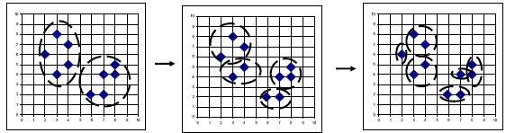
Hierarchical Clustering
Agglomerative process-
Each unit is an entity to start with
Merge those two units first which are most similar (least distance) — now becomes an entity
Examine mutual distance between entities
Merge those two that are most similar
Repeat the process and go on merging till all are merged to form one entity
At each stage of agglomerative process, note the distance between the two merging entities
Choose that stage which shows sudden jump in this distance (Since it indicates that two very dissimilar entities are being merged). This could be subjective.
Divisive process-
Starts with all objects in one large cluster and then subdivides it until some condition is satisfied.

Slide 15
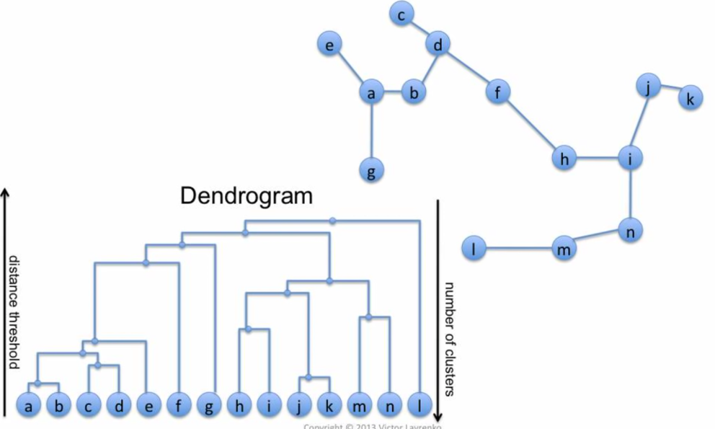
Hierarchical Clustering: Visual Representation (1/2)

Slide 16
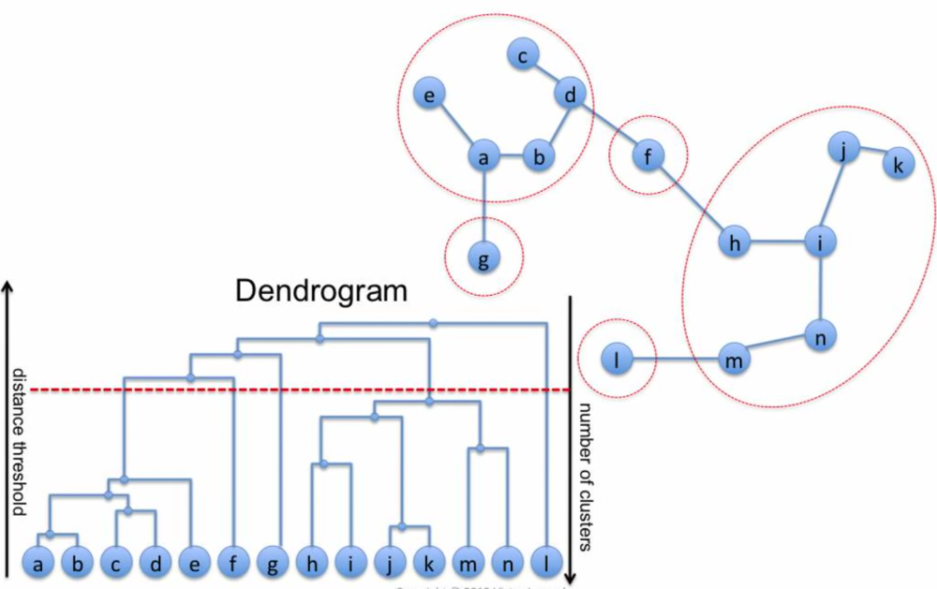
Hierarchical Clustering: Visual Representation (2/2)

Slide 17
Bottom-up vs. Top-down
Which one is more complex?
Top-down
Because additional splitting algorithm is needed as a “subroutine”
Which one is more accurate?
Top-down
Bottom-up methods make clustering decisions based on local patterns without initially taking into account the global distribution. These early decisions cannot be undone.
Top-down clustering benefits from complete information about the global distribution when making top-level partitioning decisions.

Slide 18
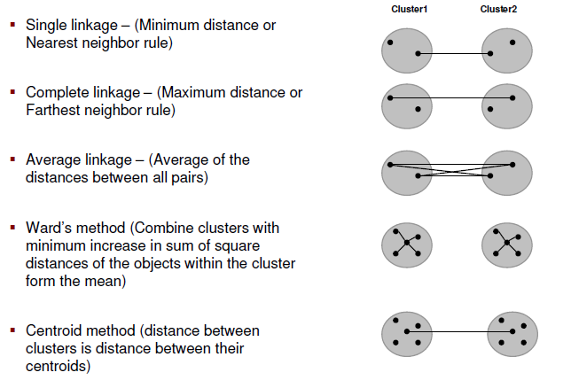
Various methods for Hierarchical Clustering (1/2)

Slide 19
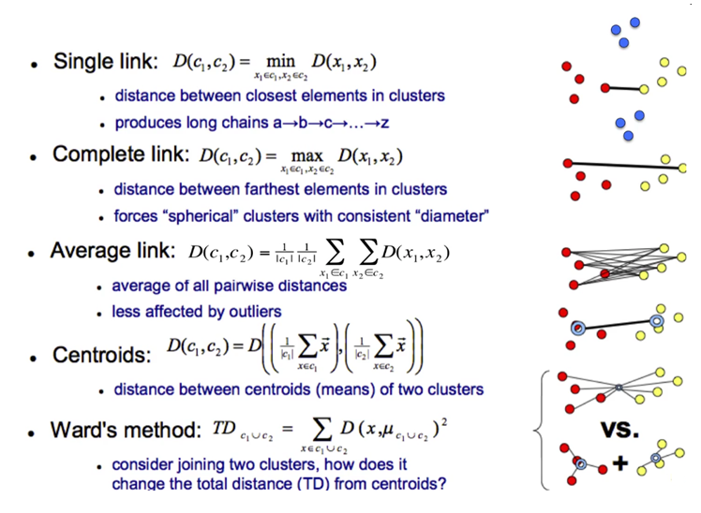
Various methods for Hierarchical Clustering (2/2)

Slide 20
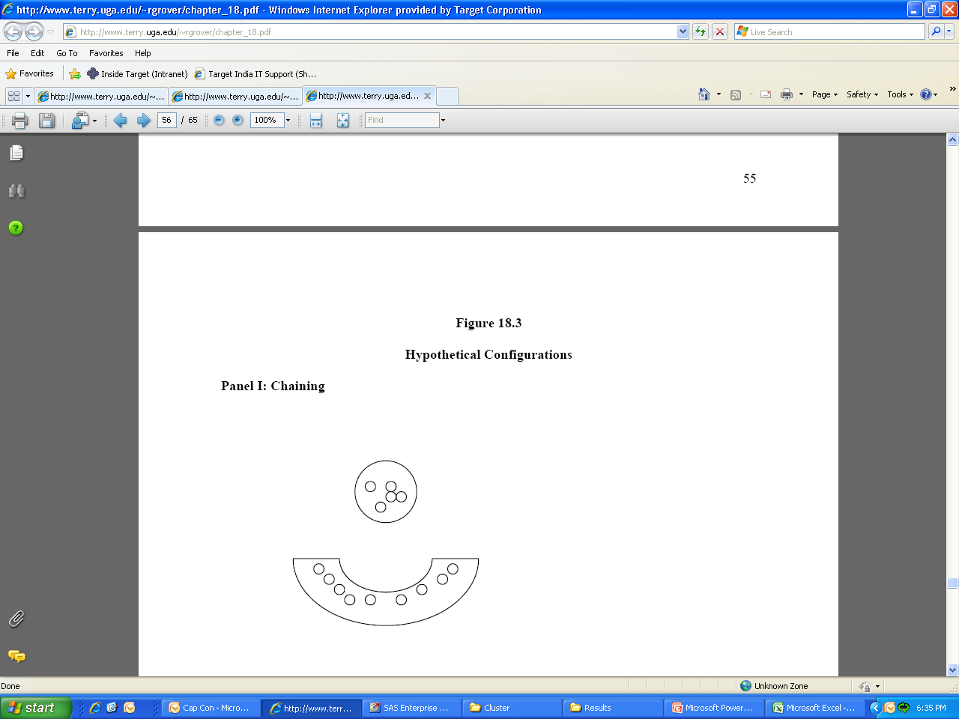
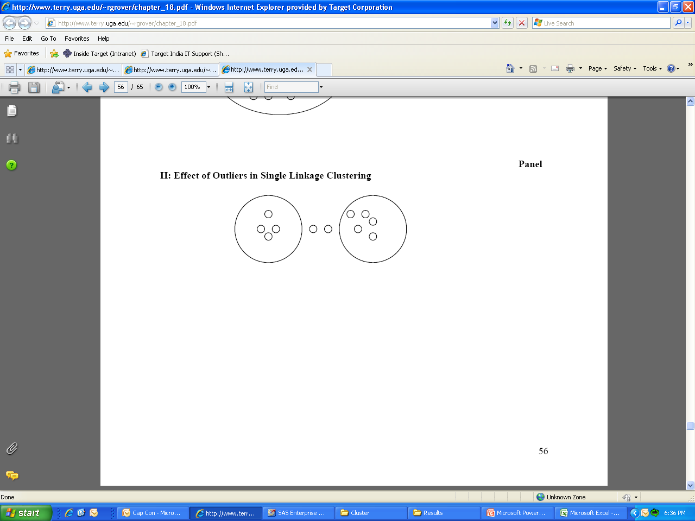
Which Hierarchical Method Is the Best?
Single linkage is particularly susceptible to chaining, more so than other methods
Single linkage will tend to merge the two clusters because of the presence of outliers. On the other hand, complete linkage will not.
Complete linkage method will identify compact homogeneous clusters
The Wards method identifies clusters of nearly equal shape and size.
It is suggested that one should use all the methods and compare the resulting solutions for interpretability of the clusters
Chaining
Effect of Outliers

Slide 21
Hierarchical Clustering- an Example
A major soft drink company is interested in introducing a soft drink
Customers were asked to taste the soft drink and the following two questions were asked.
Degree to which the consumers liked the taste of the new soft drink on a 0-100 scale
Purchase likelihood using an eleven-point scale
Based on the responses collected, each customer is plotted in a two dimensional axis
High taste reaction - Low purchase Likelihood
High taste reaction - High purchase likelihood
Low taste reaction - Low purchase likelihood
Low taste reaction - High purchase likelihood

Slide 22
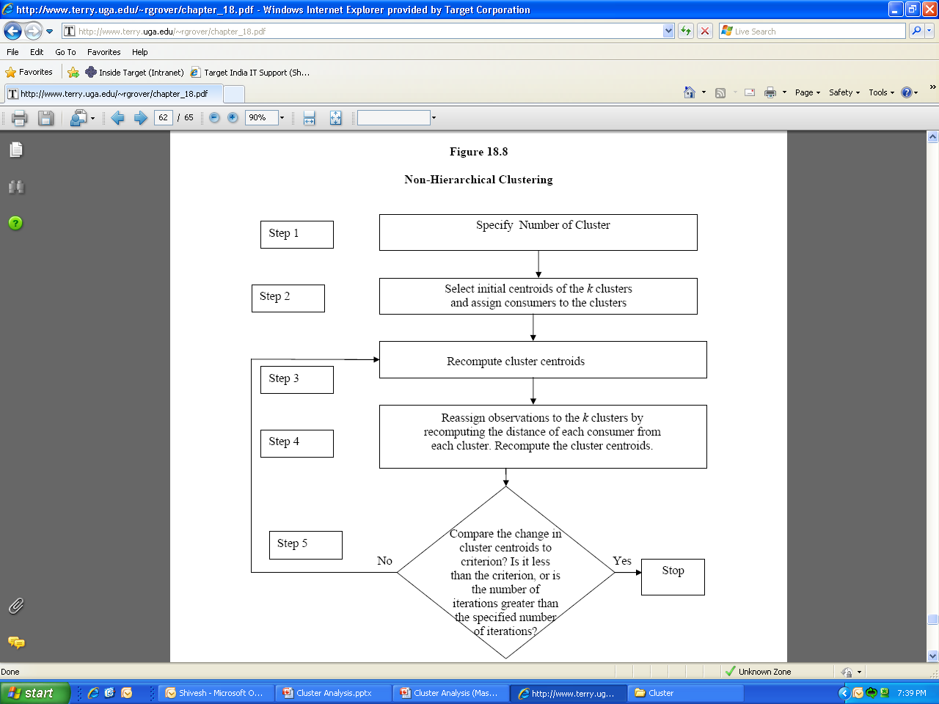
Non-Hierarchical Clustering

Slide 23
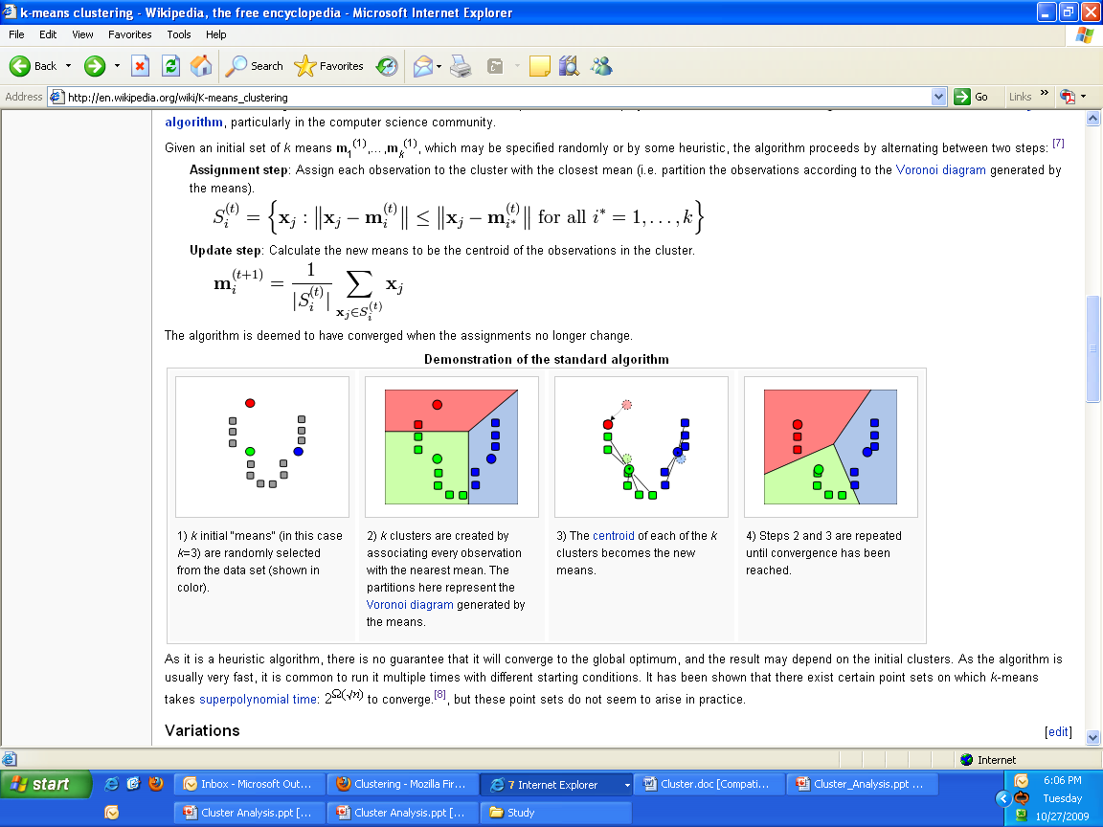
K-Means Clustering
Question- How do I know the value of K?

Slide 24
Statistics to decide optimal Number of Clusters
R-Square: For a given data set “Total amount of Variation” is fixed.
If there is k Clusters in the solution then Total Variation = Within Variation + Between Variation
Within Variation = (Variation within Cluster 1) + (Variation within Cluster 2) + … + (Variation within Cluster k)
Between Variation = Variation between one cluster to another (i.e. variation of cluster means).
So, R-Square = (Between Variation)/(Total Variation)
Higher R-Square signifies high “between” variation and low “within” variation. Thus Higher the R-Square, the better it is.
Approximate Expected Overall R-square :
Approximate Expected Overall R-Square is calculated based on the hypothesis that all the explanatory variables used for Clustering are independent.
Hence if there is a lot of difference between Observed Overall R-square and Approximate Expected Overall R-square, we can suspect high correlation among the independent variables.
RMSSTD :
RMSSTD within a cluster = Square root of Average of (Variance of variable 1 in that cluster, Variance of variable 2 in that cluster, … ,Variance of variable p in that cluster) . Assuming p variables were used for Clustering.

Slide 25

Statistics to decide optimal Number of Clusters
Cubic Clustering Criterion:
Comparative measure of the deviation of the clusters from the distribution expected if data points were obtained from a uniform distribution
Larger positive values of the CCC indicate a better solution, as it shows a larger difference from a uniform (no clusters) distribution.
Large negative Values indicate the presence of Outliers
Pseudo F:
The pseudo F statistic measures the separation among all the clusters at the current level
Relatively large values indicate a stopping point. Reading down the PSF column, find all possible stopping points (where PSF is very large compared to other values).
The optimal number of clusters is found at a point where CCC and Pseudo-F reach maximum and Overall R-Sqr tapers off.
Pseudo t² :
the pseudo t² measuring the separation between the two clusters most recently joined
The rule for interpreting the values of the pseudo t² statistic is to move down the column until you find the first value markedly larger than the previous value and move back up the column by one cluster.

Slide 26
Statistics to decide optimal Number of Clusters – Contd.
Silhouette Score - The silhouette coefficient is a measure of the compactness and separation of the clusters. Higher values represent a better quality of cluster. The silhouette coefficient is higher for compact clusters that are well separated and lower for overlapping clusters. Silhouette coefficient values do change from -1 to 1, and the higher the value is, the better. The silhouette coefficient is calculated per instance. For a set of instances, it is calculated as the mean of the individual sample's scores.
Silhouette Score= b(i) – a(i)
max {a(i),b(i)}
A is the min distance between the instances in the cluster; b is the mean distance between the instance and the instances in the next closest clusters.
Elbow Method: The Elbow method is a method of interpretation and validation of consistency within cluster analysis designed to help finding the appropriate number of clusters in the data set. One simple heuristic is to compute the total within sum of squares (WSS) for different values of k and look for an “elbow” in the curve. Define the cluster’s centroid as the point that is the mean value of all the points in the cluster. The within sum of squares for a single cluster is the average squared distance of each point in the cluster from the cluster’s centroid. The total within sum of squares is the sum of the within sum of squares of all the clusters. The total WSS will decrease as the number of clusters increases, because each cluster will be smaller and tighter. The hope is that the rate at which the WSS decreases will slow down for k beyond the optimal number of clusters. In other words, the graph of WSS versus k should flatten out beyond the optimal k, so the optimal k will be at the “elbow” of the graph. Unfortunately, this elbow can be difficult to see.
CH Index(Calinski-Harabasz): The Calinski-Harabasz index of a clustering is the ratio of the between-cluster variance (which is essentially the variance of all the cluster centroids from the dataset’s grand centroid) to the total within-cluster variance (basically, the average WSS of the clusters). For a given dataset, the total sum of squares (TSS) is the squared distance of all the data points from the dataset’s centroid. The TSS is independent of the clustering. If WSS(k) is the total WSS of a clustering with k clusters, then the between sum of squares BSS(k) of the clustering is given by BSS(k) = TSS - WSS(k). WSS(k) measures how close the points in a cluster are to each other. BSS(k) measures how far apart the clusters are from each other. A good clustering has a small WSS(k) and a large BSS(k).The within-cluster variance W is given by WSS(k)/(n-k), where n is the number of points in the dataset. The between-cluster variance B is given by BSS(k)/(k-1). The within-cluster variance will decrease as k increases; the rate of decrease should slow down past the optimal k. The between-cluster variance will increase as k, but the rate of increase should slow down past the optimal k. So in theory, the ratio of B to W should be maximized at the optimal k.

Slide 27
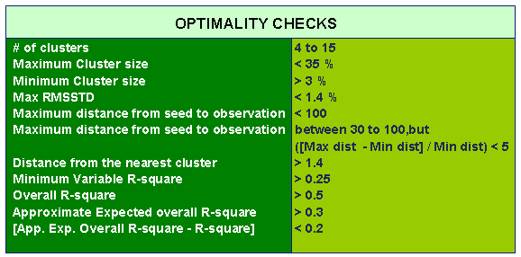
Cluster Solution
The Potential Cluster Solution should ideally satisfy most of these optimality checks if not all

Slide 28
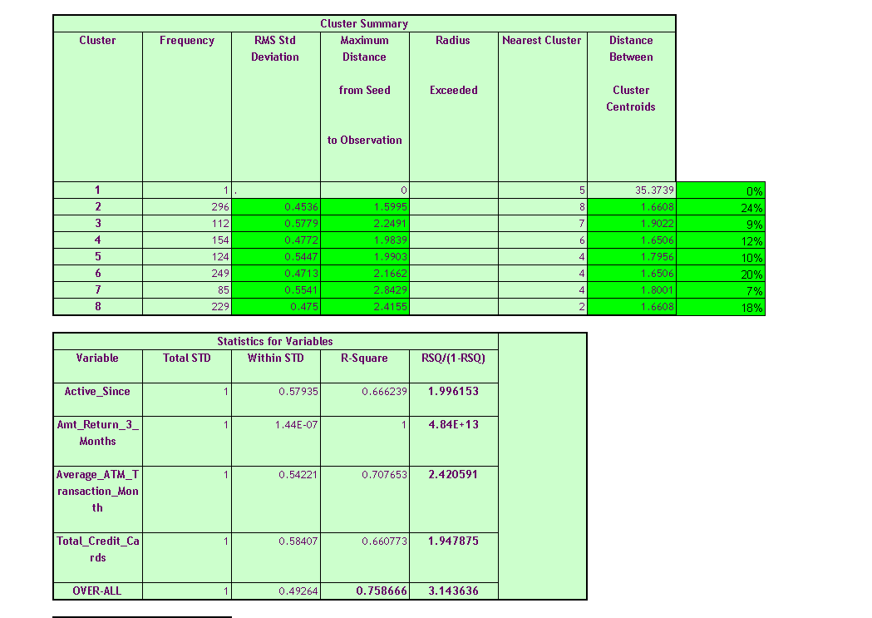
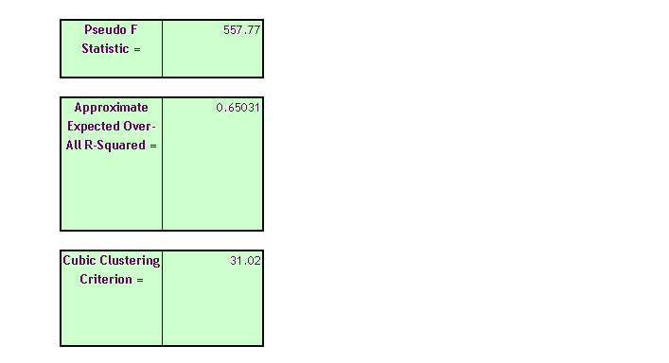
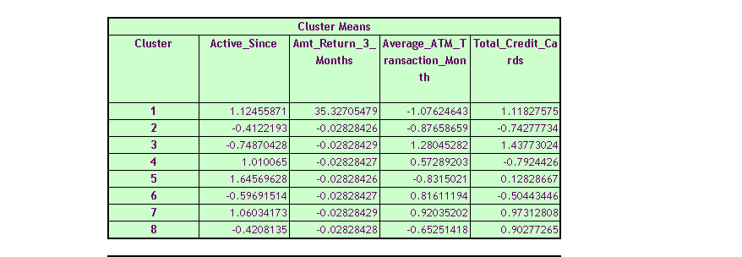
Cluster Building – Cluster Solution

Slide 29
Clustering EXERCISE – Hierarchical/K-means
Preparing The Data:
To demonstrate clustering exercise, we’ll use a small dataset from 1973 on protein consumption from nine different food groups in 25 countries in Europe.1 The goal is to group the countries based on patterns in their protein consumption. The dataset is loaded into R as a data frame called protein.
We will use this dataset primarily to showcase different usage of clustering algorithms and how we can design solutions through unsupervised learning.

Slide 30
The Philosophy of Cluster Validation
One way to assess whether a cluster represents true structure is to see if the cluster holds up under plausible variations in the dataset. The basic general strategy is as follows:
Cluster the data as usual.
Draw a new dataset (of the same size as the original) by resampling the original dataset with replacement and cluster the same dataset
For every cluster in the original clustering, find the most similar cluster in the new clustering (the one that gives the maximum Jaccard coefficient) and record that value. If this maximum Jaccard coefficient is less than 0.5, the original cluster is considered to be dissolved—it didn’t show up in the new clustering. A cluster that’s dissolved too often is probably not a “real” cluster.
Repeat steps 2–3 several times.
The cluster stability of each cluster in the original clustering is the mean value of its Jaccard coefficient over all the bootstrap iterations. As a rule of thumb, clusters with a stability value less than 0.6 should be considered unstable. Values between 0.6 and 0.75 indicate that the cluster is measuring a pattern in the data, but there isn’t high certainty about which points should be clustered together. Clusters with stability values above about 0.85 can be considered highly stable (they’re likely to be real clusters).Different clustering algorithms can give different stability values, even when the algorithms produce highly similar clusters, so clusterboot() is also measuring how stable the clustering algorithm is.
Assigning New Points to Clusters:
After the clustering analysis, if we need to assign a cluster-category for new observations, then we can do the following –
Check the original cluster profile and select the best fit.
Add the record in the cluster dataset and re-run the model to test where it fits.
Discriminant analysis can be done
Minimum Euclidean Distance method can be considered (same as scoring a dataset)

Slide 31
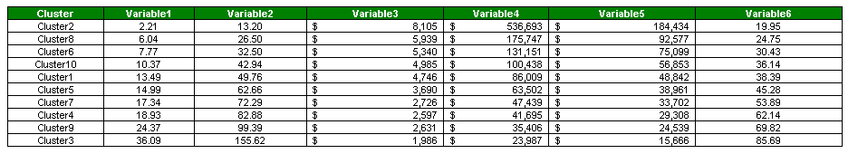
Cluster Profiling
Check average values and frequencies for each clusters to confirm—
Whether Clusters are distinct enough or not
Whether Clusters are making business sense
Whether objective of preparing clusters are fulfilled
R Code/Relevant Doc:

Slide 32
Other Types of Clustering – enter into the Bigger Universe
Apart from what we discussed as methods for Clustering there are lot of other types of clustering algorithms: To name a few -----
Clara Algorithm
PAM Algorithm
Kernel Weighted K-Means
Fuzzy K-Means
Fuzzy K- Medoids
K-Modes Clustering
Clustering of Binary Variables
Bagged Clustering
Affinity Propagation Clustering
Density-Based Cluster Analysis
Rousseeuw-Kaufman’s Fuzzy Clustering Method

